Slide 1
FA565 Business Ethics and Corporate Governance
Week 4: Shareholders & Employees
Mark Elliot

Slide 2
Overview: Shareholders, Employees & Business Ethics
The nature of shareholder relations to the corporation
Analysis of the rights and the duties of shareholders
Specific ethical problems and dilemmas arising in the relation between companies and their shareholders
The ethical implications of globalization on shareholder relations
The specific role of employees among the various stakeholder groups
Core ethical topics of employees’ rights and duties
Ethical issues and problems faced in business-employee relations
The implication of sustainability for workplaces and for specific working conditions

Slide 3

Shareholders

Slide 4
Discussion
What are the main challenges around the ethical conduct of companies towards their shareholders?

Slide 5
Rights & Duties in Firm-Shareholder Relations
Rights of shareholders
The right to sell their stock
The right to vote in the general meeting
The right to certain information about the company
The right to sue the managers for (alleged) misconduct
Certain residual rights in case of the corporation’s liquidation
Duties of managers
Duty to act for the benefit of the company
Duty of care and skill
Duty of diligence
Notes:
Q: Why does this lead to a possible conflict between shareholders and managers?

Slide 6
Corporate governance: a principal-agent relationship
Principal - Shareholder
Conflict of interest:
Maximisation of profits vs. high salaries
Informational asymmetry:
Shareholders have limited information about management’s activities
Seeks profits, rise in share price, etc.
Seeks remuneration, power, esteem, etc.
Agent - Management
Notes:
CG aims to put principles in place to ensure that managers act in the interests of shareholders.
Auditors etc help with info asymmetry

Slide 7
Ethical issues in Corporate Governance
Executive accountability and control
Effective CG depends on executive accountability
Executive remuneration
Performance-related pay leads to large salaries that cause unrest within corporations. (E.g. Average CEO salary in US was $15.6 million in 2016, 270 times more than the average salary.)
Influence of globalisation on executive pay leads to significant increases.
Mergers and acquisitions
Hostile takeovers
Executive directors vs. (supervisory) non-executive officers
Diversity
Diverse boards (backgrounds, ages, gender, ethnicity, sexual orientation, etc.) correlate with positive financial performance.
Acquisitions at the expense of other stakeholdrs

Slide 8
Financial Markets
Speculative investing (e.g. dotcom bubble)
High frequency trading
Short selling
Insider trading
Failure of financial professionals (e.g. auditor independence)
Unregulated cryptocurrencies
Notes:
Short selling e.g on next slide

Slide 9
Short selling example
19 September 2022:
Borrow: £1m
Exchange to USD at £1: $1.14 → $1.14m
23 September 2022:
Exchange back to GBP at £1: $1.08 → £1.05m
Pay back lender: £1m
Keep excess: £55k
Notes:
Also insider trading

Slide 10
Financial Markets
Speculative investing (e.g. dotcom bubble)
High frequency trading
Short selling
Insider trading
Failure of financial professionals (e.g. auditor independence)
Unregulated cryptocurrencies

Slide 11
Shareholders and globalisation: Global financial markets
Global financial markets are the total of all physical and virtual (electronic) places where financial titles in the broadest sense (capital, shares, currency, options, etc.) are traded worldwide.
Governance and control
National security and protectionism
Speculation
Unfair competition with developing countries
Space for illegal transactions
Notes:
Why is regulation difficult when shares are traded on international markets
Illegal transactions – tax havens, paradise papers

Slide 12
Reforming corporate governance around the globe
Some important shortcomings in present systems of governance in many countries
Main tool in Europe is corporate governance codes
Legal basis and power of these codes varies dramatically
US response – Sarbanes-Oxley
Islamic finance
E.g. prohibition of interest, speculation, etc.; requirement for financial products to be backed by a tangible asset, etc.

Slide 13
Shareholders as citizens of the corporation
Shareholder democracy
Idea that a shareholder of a company is entitled to have a say in corporate decisions
Can shareholders be a force for wider social accountability and performance?
Shareholder activism
Buy shares in company for right to speak at the annual general meetings
Voice concern and challenge the company on allegedly unethical practices
Socially responsible investment (SRI)
Investment decisions that combine the search for financial returns with achievement of social, ethical and environmental goals.
Sustainability
Sustainability indices
Alternative models of ownership, e.g. cooperatives

Slide 14
Employees

Slide 15
Discussion
What are the main ethical issues that face companies in their ethical treatment of employees?

Slide 16
Management of human resources
The term ‘human resource management’ and its implications have been a subject of intense debate in business ethics
Humans treated as important and costly resource Consequently, employees are subject to a strict managerial rationale of minimising costs and maximising the efficiency of the ‘resource’
Notes:
“Labour” factor of production in Economics

Slide 17
Employee Rights & Employee Duties
Central ethical issues in HRM revolve around rights and duties.
Employee rights:
Entitlements of workers with respect to their employer, based on a general understanding of human rights and often codified in employment law.
Employee duties:
Obligations of workers towards their employer, based on individual contracts and wider employment laws.

Slide 18
Employee Rights
Freedom from discrimination
Privacy
Due process
Participation & association
Healthy & safe working conditions
Fair wages
Freedom of conscience & speech
Work (e.g. recruitment practices)

Slide 19
Employee Duties
Compliance with labour contract
Compliance with the law (e.g. bribery)
Respect the employer’s property

Slide 20
Ethical Issues
Modern Slavery
Gig Economy
Equality, Diversity & Inclusion; Discrimination
Gender, LGBTQ, Age, Maternity, etc.
Sexual and racial harassment
#MeToo
Employee privacy
Health and drug testing
Electronic privacy and data protection
Due process and lay-offs
National culture and moral values

Slide 21
Ethical Issues – Modern Slavery
People who are forced to work through threat
People who are owned or controlled by an employer particularly through mental, physical or threatened abuses
People who are de-humanized and treated as a resource
People being physically constrained or their movement being controlled
People being subject to economic exploitation through underpayment

Slide 22
Ethical Issues – Gig Economy
People hired to do a specific task rather than longer term for exactly the same task
Gain flexibility but also personal economic risk
Lack of social welfare structures, e.g. holiday pay, sick pay, pensions, etc.
Distinction between “workers” and “employees”

Slide 23
Gender
 | 2000 | 2004 | 2008 | 2014 | 2017
Female held directorships (in % of total directorships | 69 (5.8%) | 110 (9.7%) | 131 (11.7%) | 231 (20.7%) | 294 (27.7%)
Female executive directors | 11 | 17 | 17 | 20 | 25
Female non-executive directors | 60 | 93 | 114 | 211 | 269
Companies with 2 women directors | 14 | 19 | 39 | 79
Companies with no women directors | 42 | 31 | 22 | 2 | 0
(FTSE 100: largest 100 companies on the Financial Times Stock Exchange Index)

Slide 24
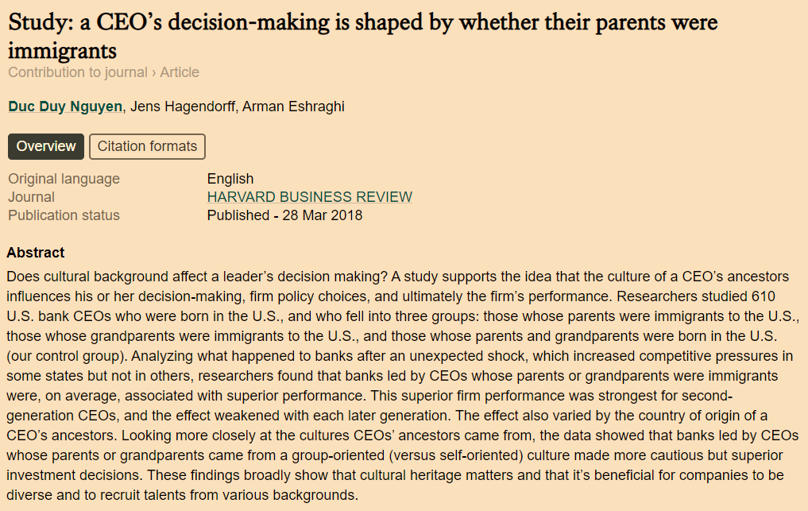
Immigrants
Notes:
CEOs whose parents/grand were immigrants performed better

Slide 25

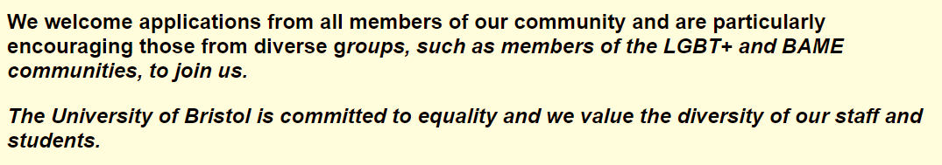
Equal Opportunities & Affirmative Action
How should organizations respond to problems of discrimination?
Equal opportunity programme
Generally targeted at ensuring procedural justice is promoted
Affirmative action (AA) programmes: deliberately attempt to target those who might be currently under-represented in the workforce
Recruitment policies
Fair job criteria
Training programmes for discriminated minorities
Promotion to senior positions
Source: Recruitment of Lecturers (Assistant Professors) in Accounting.
https://www.jobs.ac.uk/job/BVX924/lecturers-assistant-professors-in-accounting (accessed 25/10/2019)

Slide 26

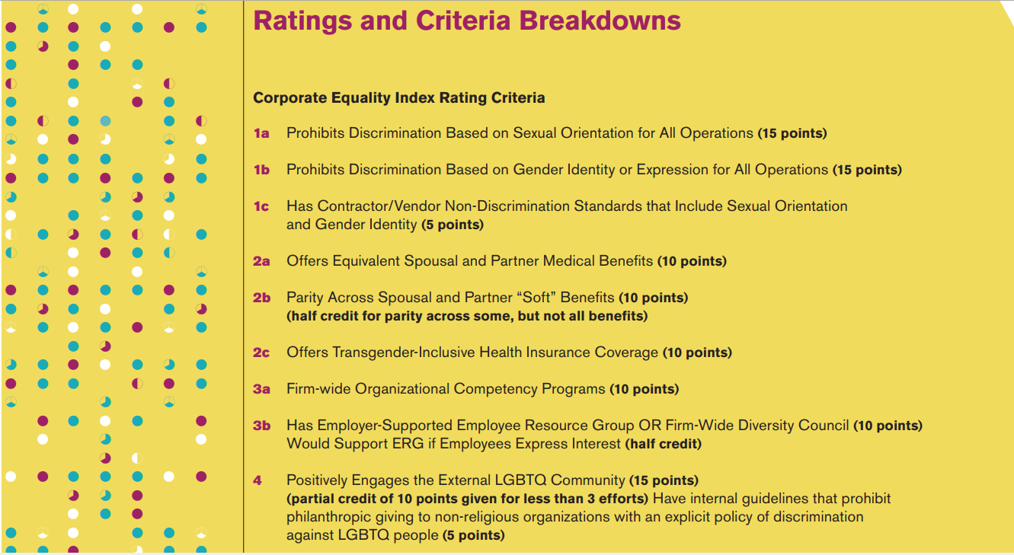
LGBTQ
Source: Human rights campaign. Available at: https://assets2.hrc.org/files/assets/resources/CEI-2018-FullReport.pdf?_ga=2.159891322.653065534.1571951284-2019403665.1571951284

Slide 27
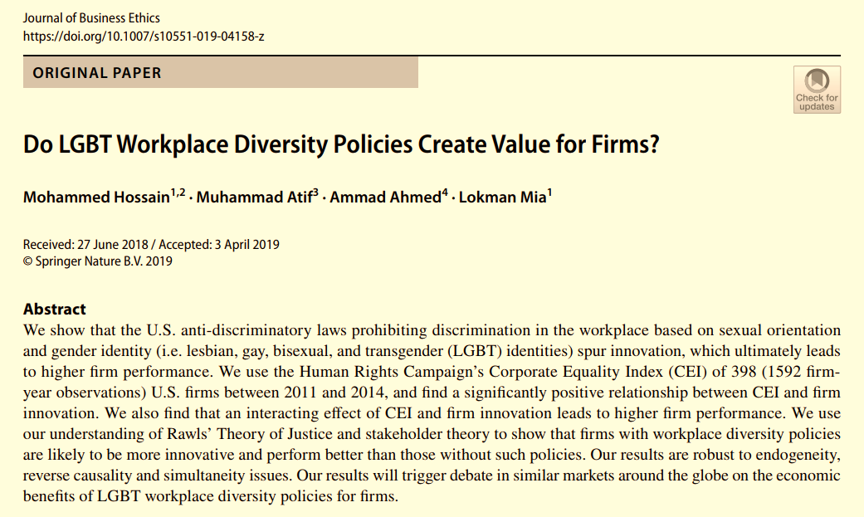
LGBTQ (cont.)

Slide 28
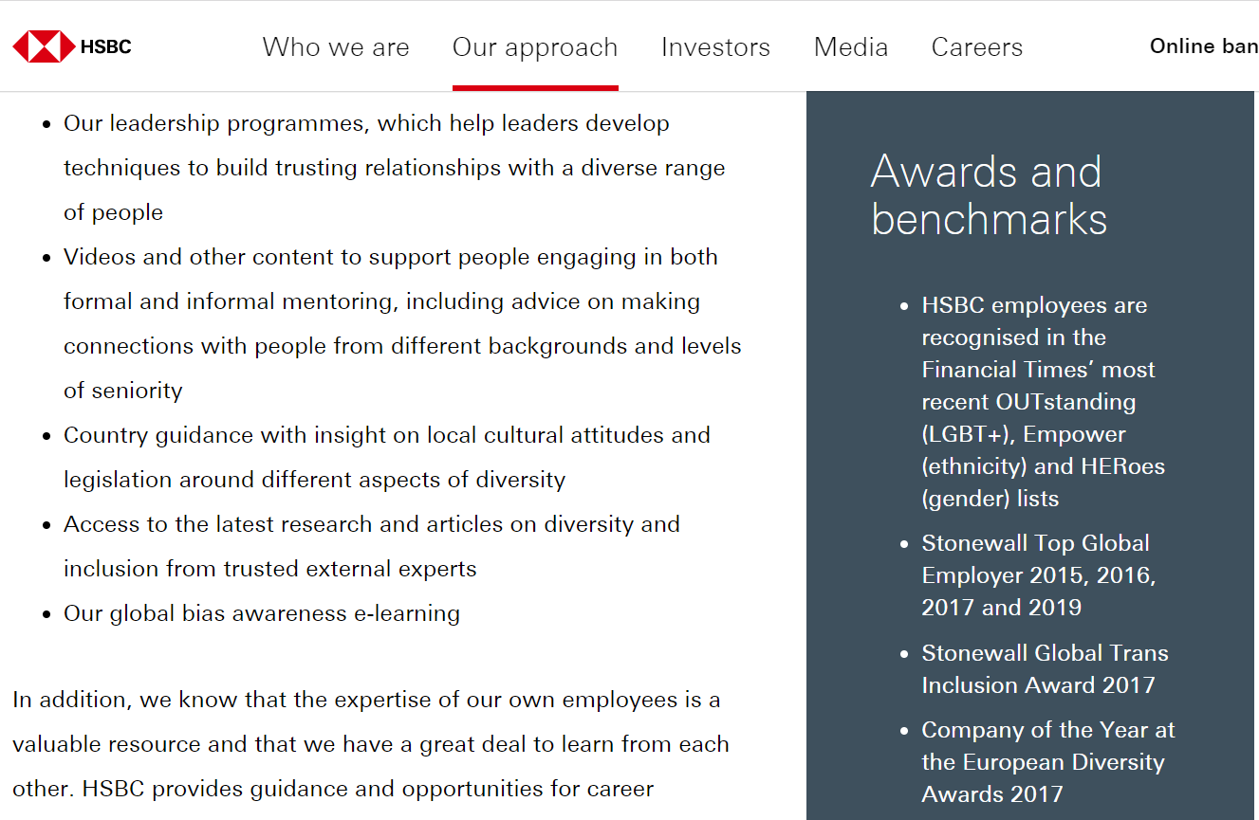
HSBC Plc (UK)
Source: HSBC. Available at: https://www.hsbc.com/our-approach/culture-and-people/diversity-and-inclusion

Slide 29
Ethical Issues
Working conditions
Excessive working hours
Work Life Balance
4-day work week
Flexible working patterns
Fair wages
Freedom of conscience and freedom of speech in the workplace

Slide 30
Towards sustainable employment
Re-humanized workplaces
Wider employment (meaningful work)
Green jobs and creating a greener workforce

Slide 31

Case Study: Professional Football Clubs

Slide 32
Question 1
Who are the main stakeholders of football clubs?
Describe their ‘stake’ in the organisation.
Assess the legitimacy of their interests (based on rights and/or effects).
What are the key governance issues that each of these stakeholders might have (inc. their duties, protection of their interests, etc.)?
Stakeholder Group | Stake | Legitimacy | Key governance issues
E.g.: Owners | High – Owns capital | Right to return on their investment | Maximisation of profits, continued support of fans

Slide 33
Question 2
What approaches (initiatives) are described in the case study for addressing these governance issues?
How likely are they to be effective?
Example: “Supporters Direct” gives fans a say in the running of the organisation.

Slide 34
Question 3
Ultimately, who ‘should’ own football clubs and what should their priorities be in managing the enterprise?

Slide 35
Coming up
Next session, we will start with the case study on Migrant Labour, so please ensure to have read it in advance!
Also, a reminder that the deadline for submitting your Assessment 1, Task A presentations is 10am on Friday.

